Slide 1
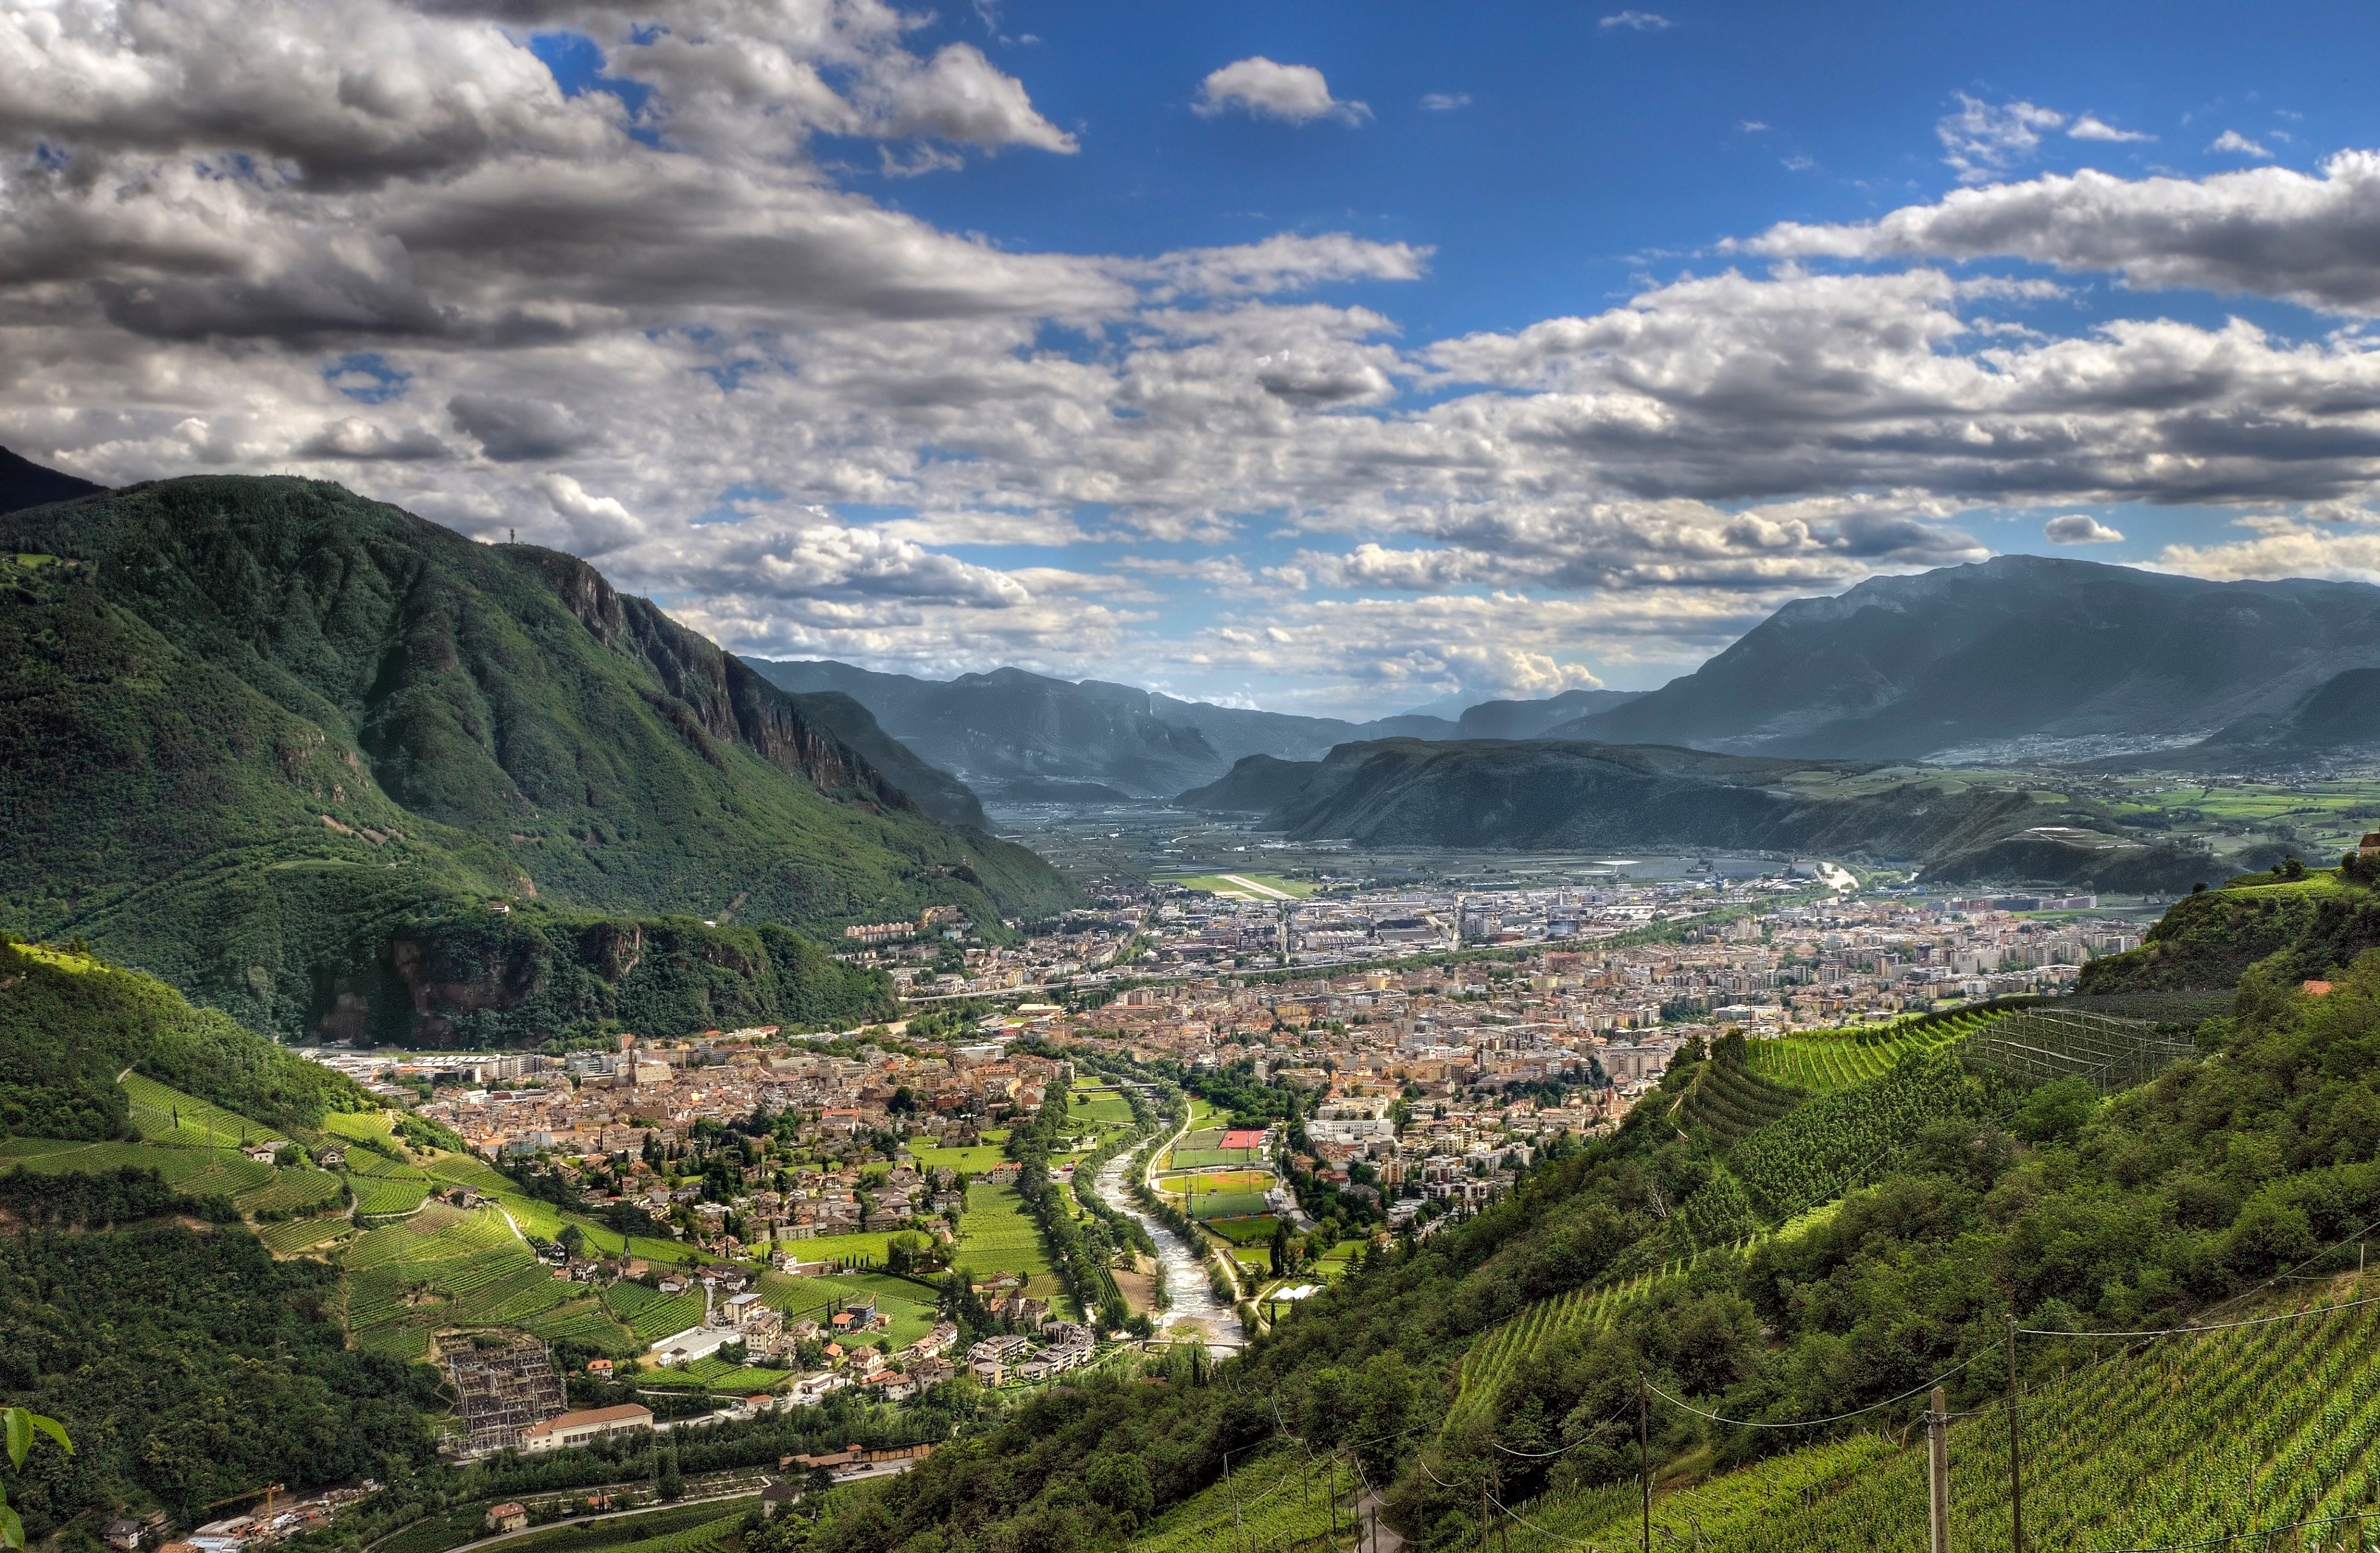

Software Engineering for Mobile Applications

Slide 2

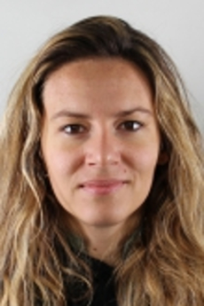

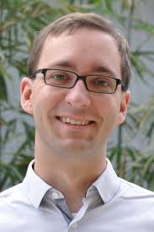
Speakers
Alessandra Gorla
IMDEA, Spain
Understanding the Behavior of Android apps by Means of Static and Dynamic Analyses
Niels Henze
University of Stuttgart, Germany
Mobile Human Computer Interaction

Slide 3

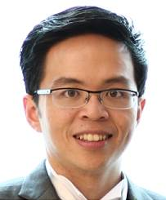
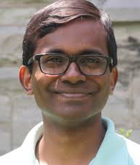
Speakers
David Lo
Singapore Management University, Singapore
Protecting Android Applications Against Attacks: Solutions and Limitations
Mei Nagappan
University of Waterloo, Canada
Trends and Challenges in Software Engineering Research for Mobile Apps, Recent advances

Slide 4
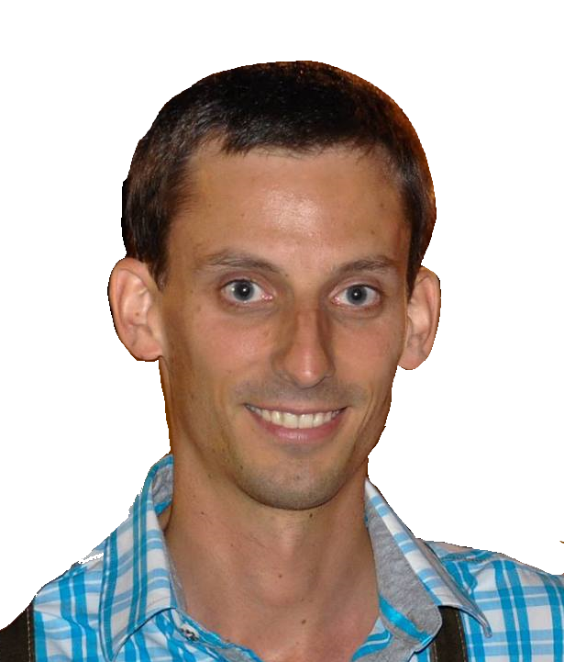
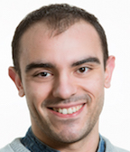
Speakers
Michael Mairegger
Free University of Bozen-Bolzano, Italy
Platform Development for Mobile Devices with Xamarin.Forms
Fabio Palomba
University of Zurich, Switzerland
Managing Source Code Quality in Mobile Apps

Slide 5
Today
Room D003
8:30
Welcome - Dean of Faculty of Computer Science
9:00
Tutorial I - Part I
10:30
11:00
Coffee Break
Tutorial I - Part II
12:30
Lunch @unibz Mensa
13:30
Tutorial II - Part I
15:00
15:30
Coffee Break
Tutorial II - Part II
17:00
One-to-one Q&A with speakers
18:00

Slide 6
Tuesday onwards
Room D003
8:30
Welcome - Rector of the Free University of Bolzano
Tutorial I - Part I
10:00
10:30
Coffee Break
Tutorial I - Part II and Q&A
12:00
Lunch @unibz Mensa
13:30
Tutorial II - Part I
15:00
15:30
Coffee Break
Tutorial II - Part II
17:00
One-to-one Q&A with speakers
18:00

Slide 7





Lunch @unibz mensa
1 first course (e.g., pasta, soups)
1 second course (e.g., meat, fish)
2 side dishes (e.g., salad, potatos) - you can choose a dessert instead of a side dish
1 fruit
bread and beverages

Slide 8

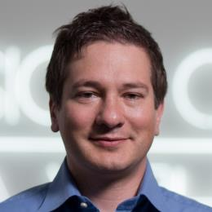
Events
Social dinner
when: Tuesday at 19:00
where: FORST restaurant
Three castles excursion
when: Wednesday afternoon after lunch
where: Appiano
Andrea Janes

Slide 9

Social Dinner @FORST
Tuesday, 19:00 - Via Goethe, 6 - 39100 Bolzano
If you cannot come, please let us know it today!

Slide 10
Coffee breaks
Next room every day
Wednesday packed lunch
Pick your box next room
Excursion clothing
Sport shoes and backpack; no sandals

Slide 11
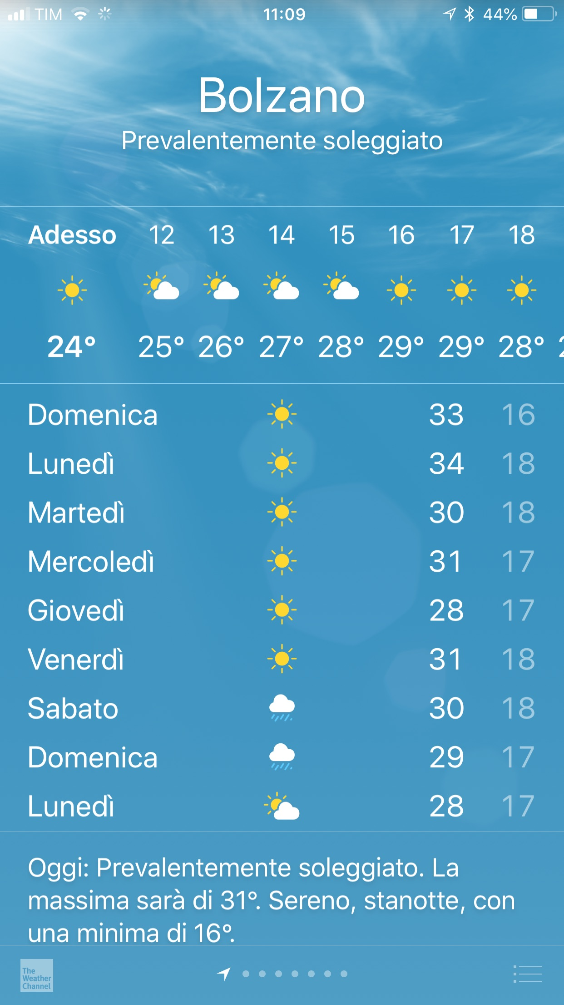

Slide 12
openAiR

Slide 13
SwSE research group

Slide 14
Links
Questionnaire on SESChool
https://goo.gl/forms/kAV3zt1wHC9Jbse33
Material
https://drive.google.com/drive/folders/1lV_z50BeqOFNeZLDS37yxRtl_7h9P-7K?usp=sharing
YouTube Channel

Slide 15
Enjoy Bolzano!

Slide 16
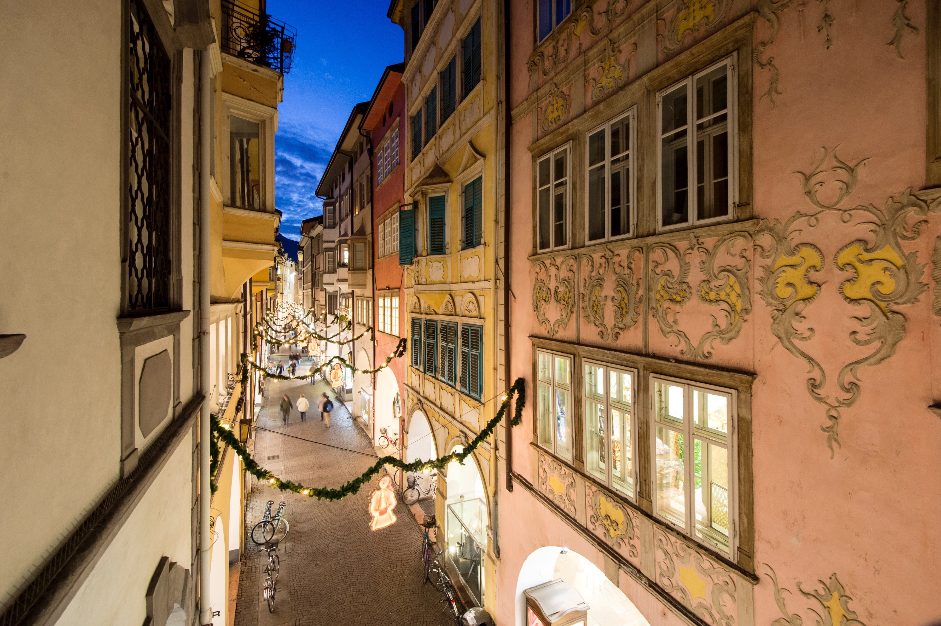
Enjoy Bolzano!

Slide 17
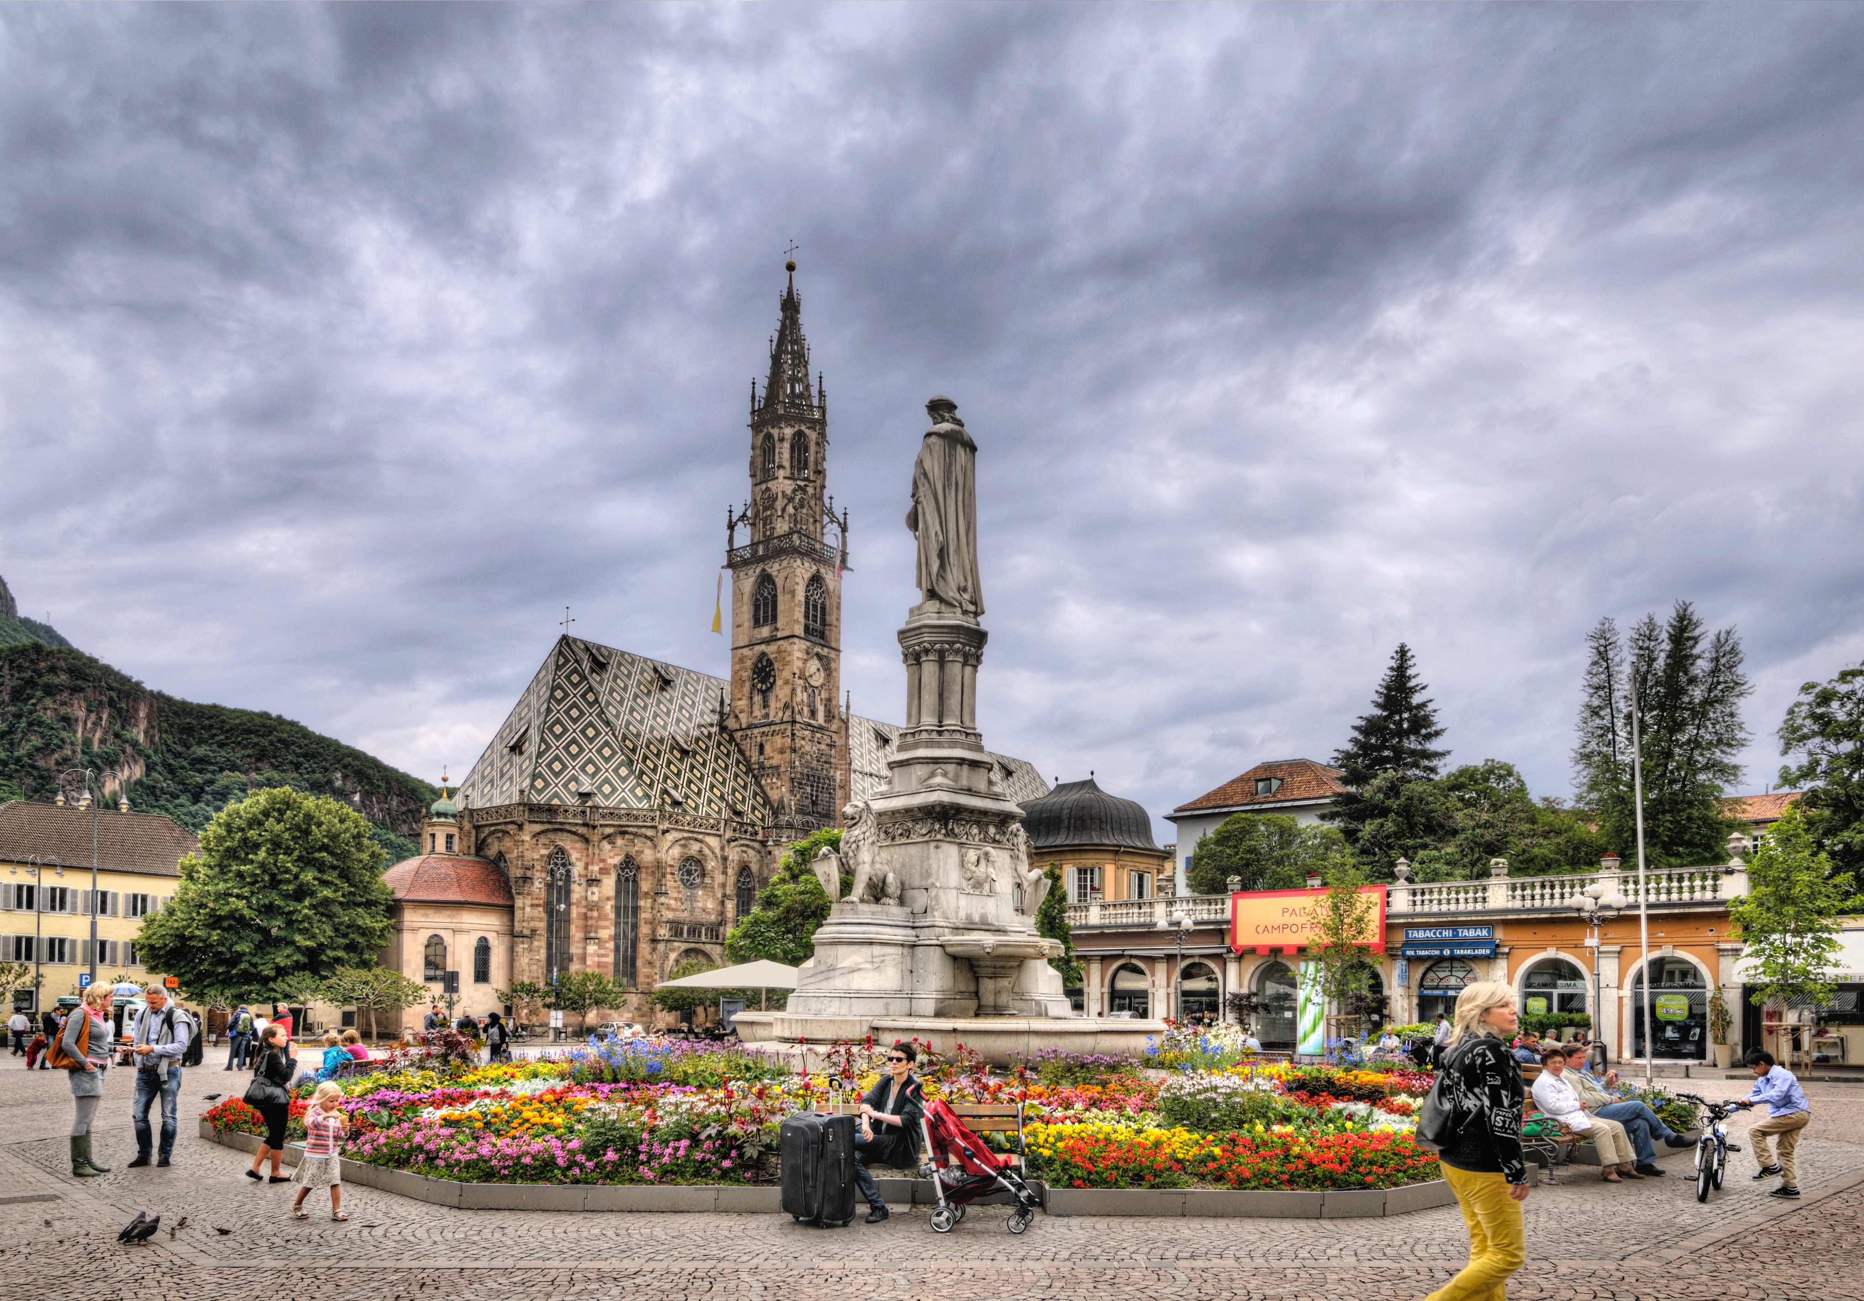
Enjoy Bolzano!

Slide 18
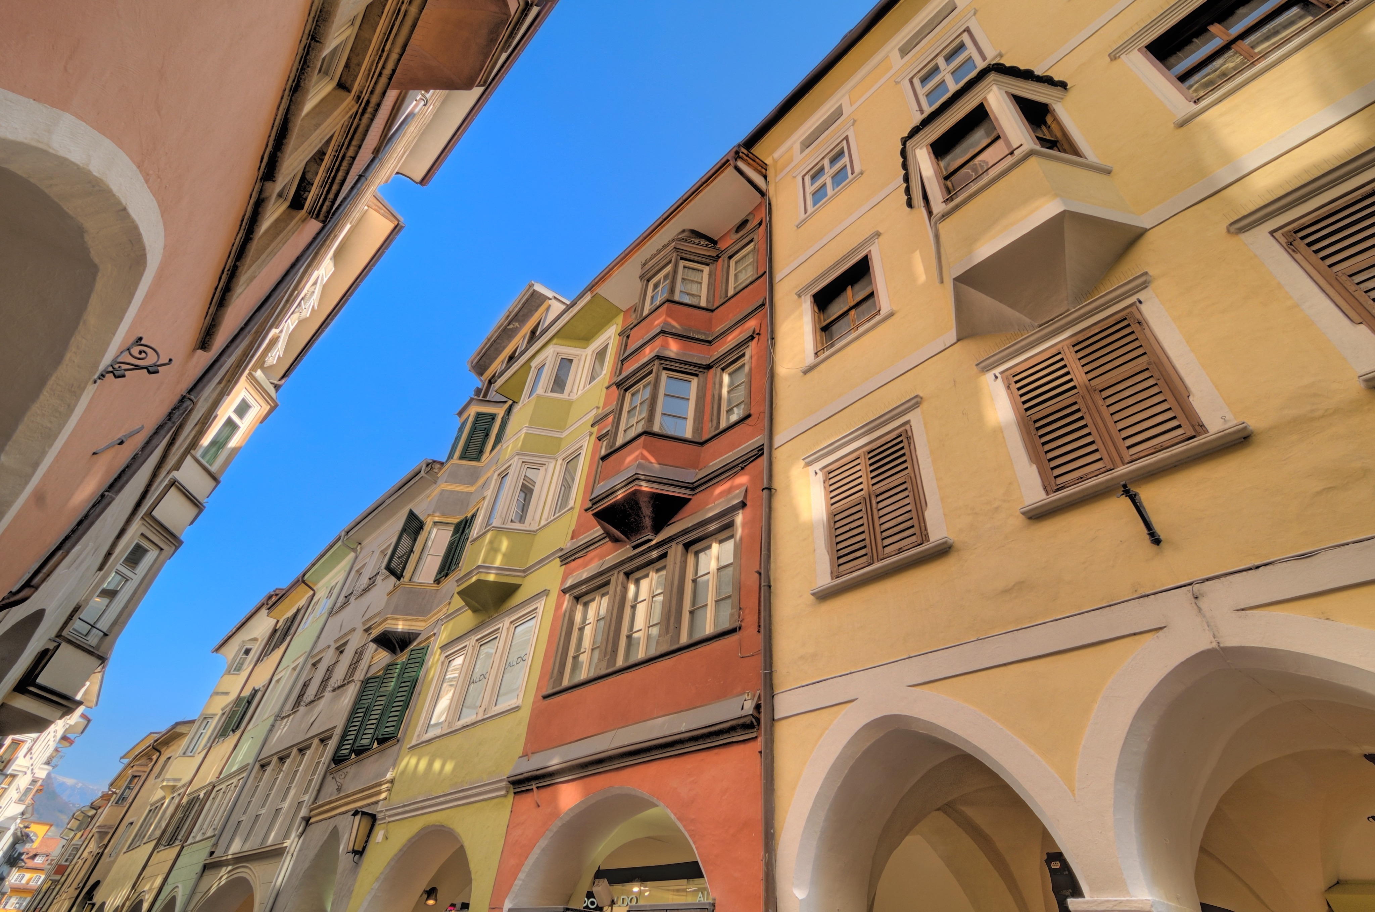
Enjoy Bolzano!

Slide 19
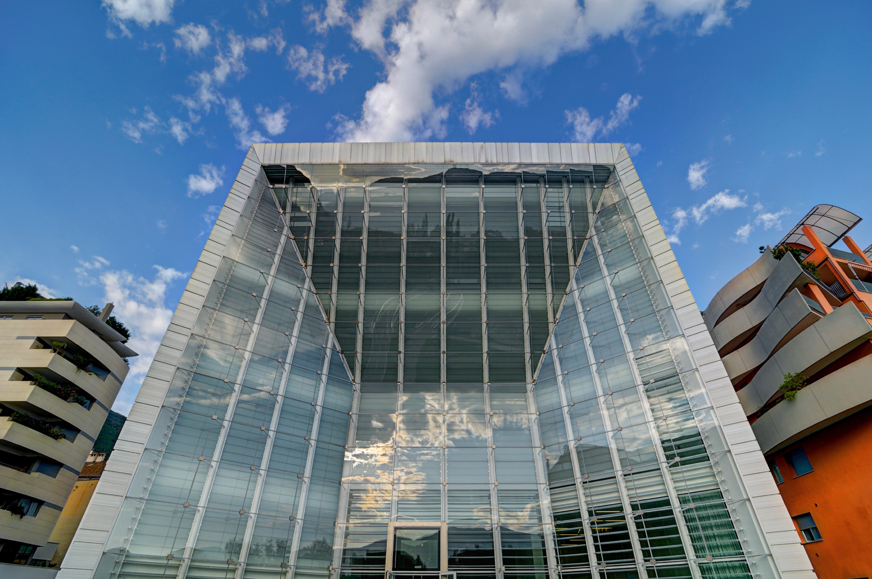
Enjoy Bolzano!

